Slide 1


BUAN 6341 Applied Machine Learning
SALES PREDICTION
FOR
VIDEO GAME COMPANIES
By,
VISHAL KANNA NATARAJAN MANOHAR
VINAY DINESH BHANUSHALI
SRIRAM KOUSHIK MAJETI

Slide 2
INTRODUCTION
As we all know, the video game industry has grown significantly in recent years, making it one of the most profitable industries in the entertainment sector. With the increasing number of games being released every year, it has become more challenging for game developers and publishers to predict their sales.
In this presentation, we will explore various machine learning models such as linear regression, decision trees, random forests, Support Vectors and how they can be used to predict video game sales accurately.

Slide 3
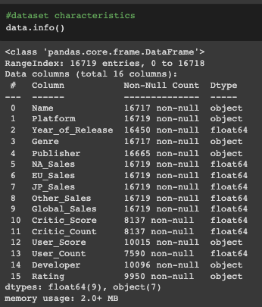
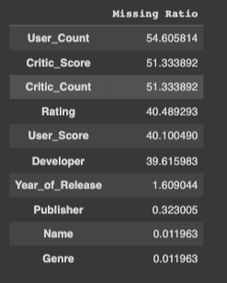
DATASET DESCRIPTION
6. Variable description
Dataset name: VideoGamesSales2016
Data source: The Dataset was webscaped from Metacritic
Data size: 16719 rows and 16 Columns
Data format: CSV
Missing Values ->

Slide 4
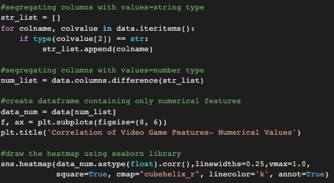
CHECKING FOR CORRELATION
Code Snippet

Slide 5
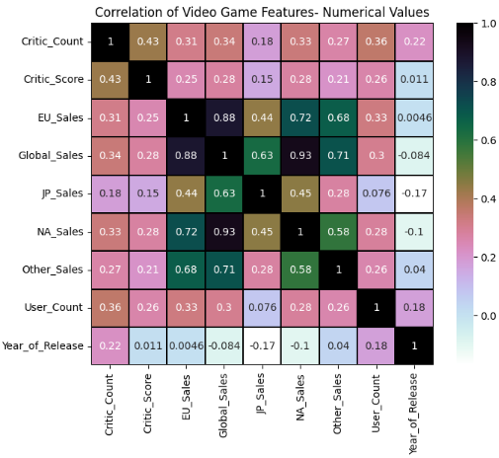
CORRELATION MATRIX
Higher correlations between sales figures points out to the reverse causality between the sales numbers in different continents. Hence, Global_Sales can be chosen as the dependent variable.

Slide 6
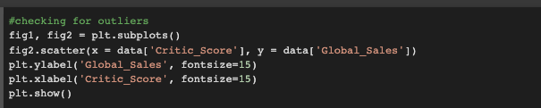
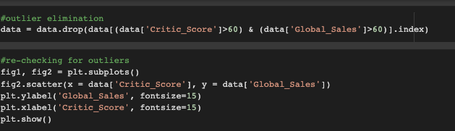
FEATURE ENGINEERING

Slide 7
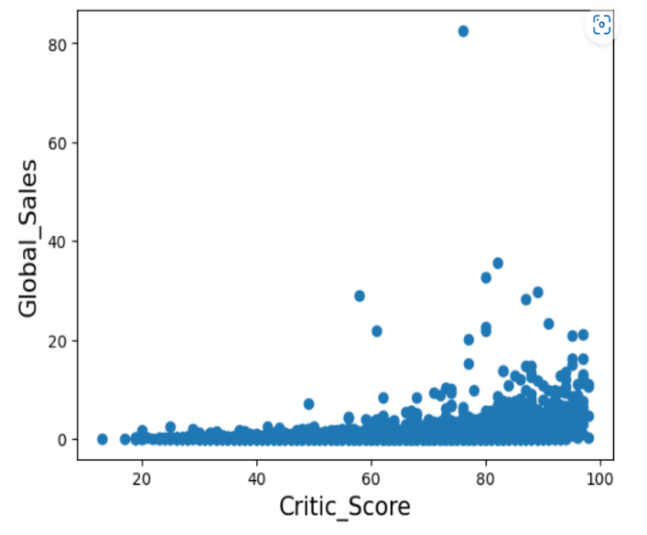
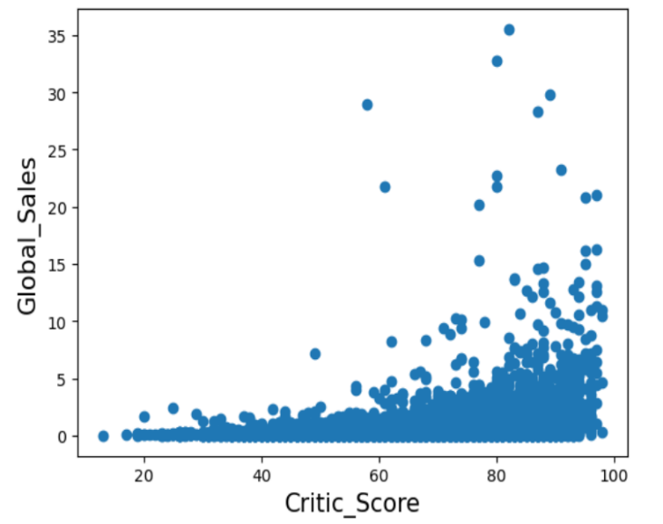
PLOT OF GLOBAL_SALES VS CRITIC_SCORE AFTER OUTLIER ELIMINATIONS

Slide 8
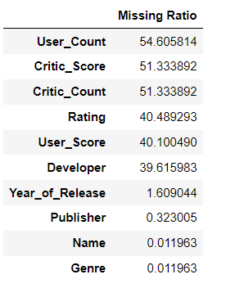
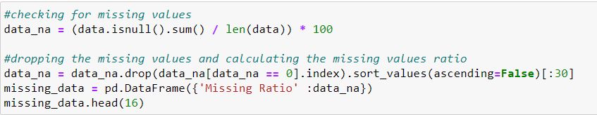
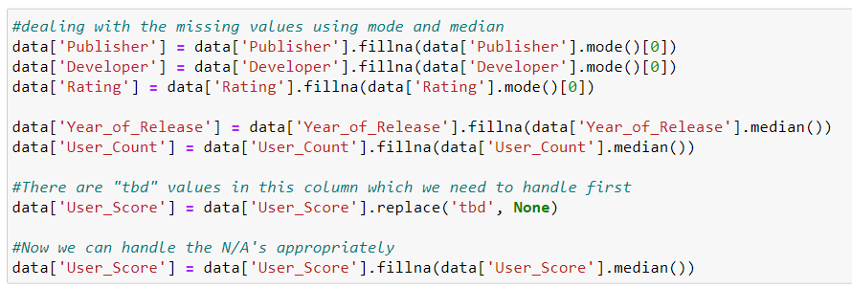
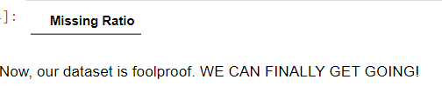
DATA CLEANING
Critic_Score could be the most important independent variable. But, we dropped it because the missing value ratio is beyond the point of repair and considering its correlation with the prospective output.

Slide 9
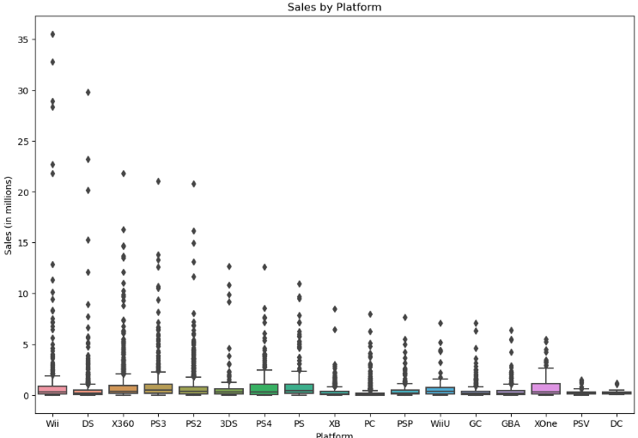
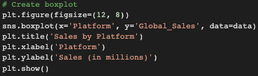
SALES BY PLATFORM
DATA VIZ

Slide 10
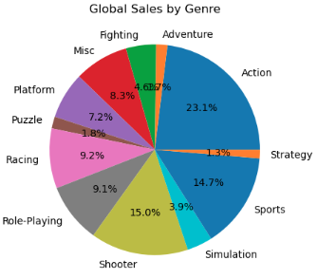
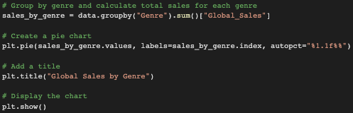
GLOBAL SALES BY GENRE

Slide 11
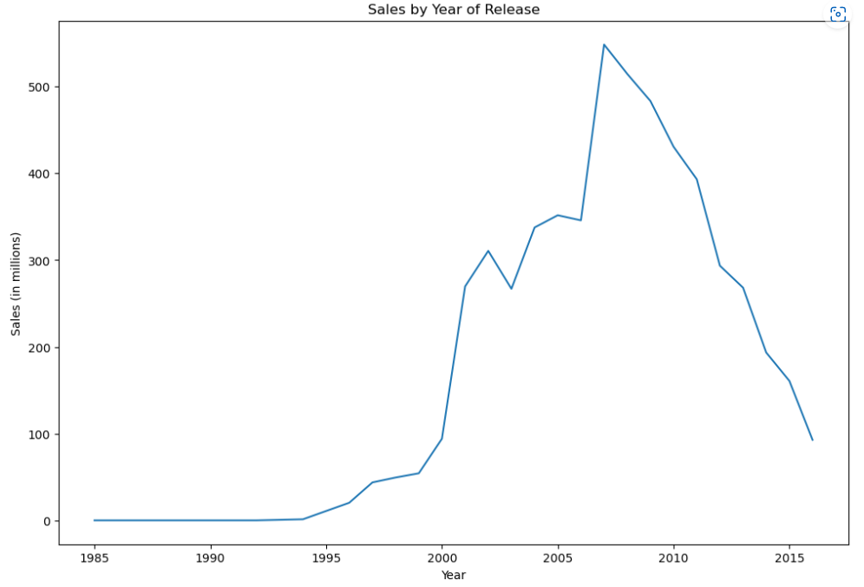
SALES VS. YEAR OF RELEASE

Slide 12
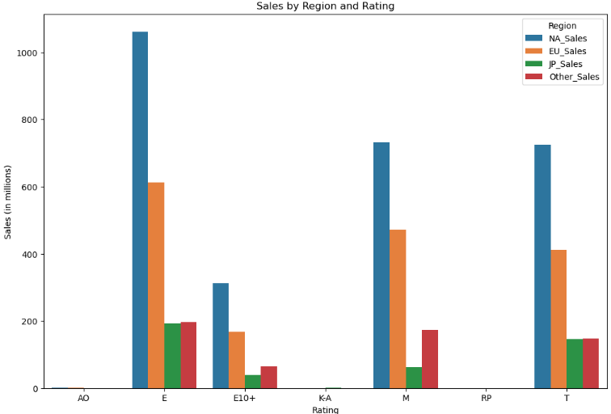
SALES BY REGION AND RATING

Slide 13
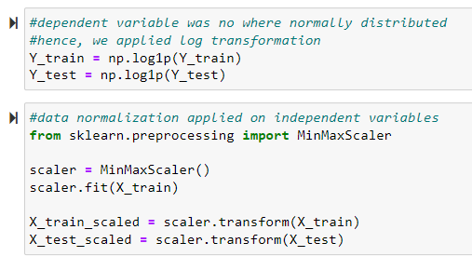
DATA SCALING AND TRANSFORMATION
Global_Sales was not typically distributed, which may have posed a concern for us in the future. Hence, we performed log transformation of the dependent variable in both the training and testing data splits.
Log transformation on dependent variable dealt with heteroscedasticity, non-linearity and non-normal distribution(skewed nature) of dataset.

Slide 14
DEMO

Slide 15
STATISTICAL MODELS FOR REGRESSION
Algorithms used to train the model of interest:
Linear Regression
Lasso Regression
Ridge Regression
K-Nearest Neighbors
Support Vector Machine
Random Forest
Gradient Boosting

Slide 16
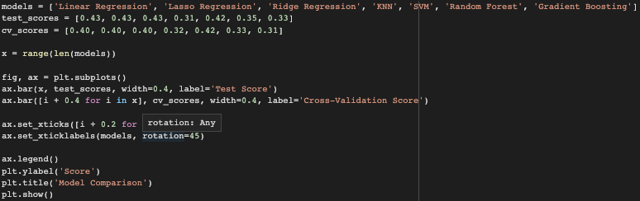
ACCURACY COMPARISION ANALYSIS
Code snippet

Slide 17
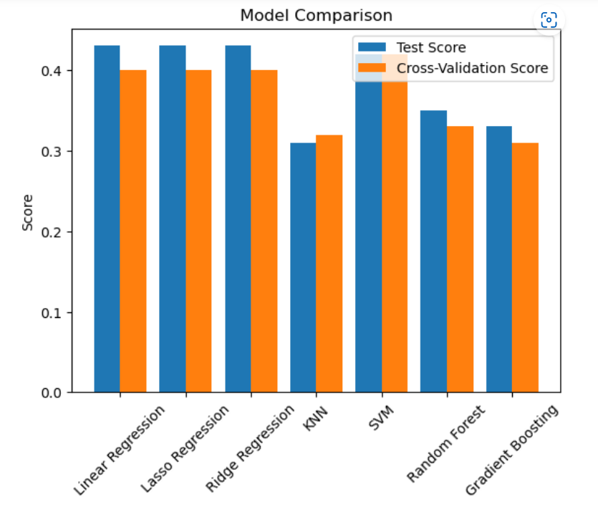
Support Vector Regressor Model is the best-performing model among the seven models that we trained, with a test score of 0.42
and a cross-validation score of 0.42. However, it is important to note that this conclusion may change if more information about
the data and the task at hand is provided.

Slide 18
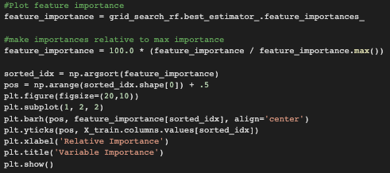
VARIABLE IMPORTANCE

Slide 19
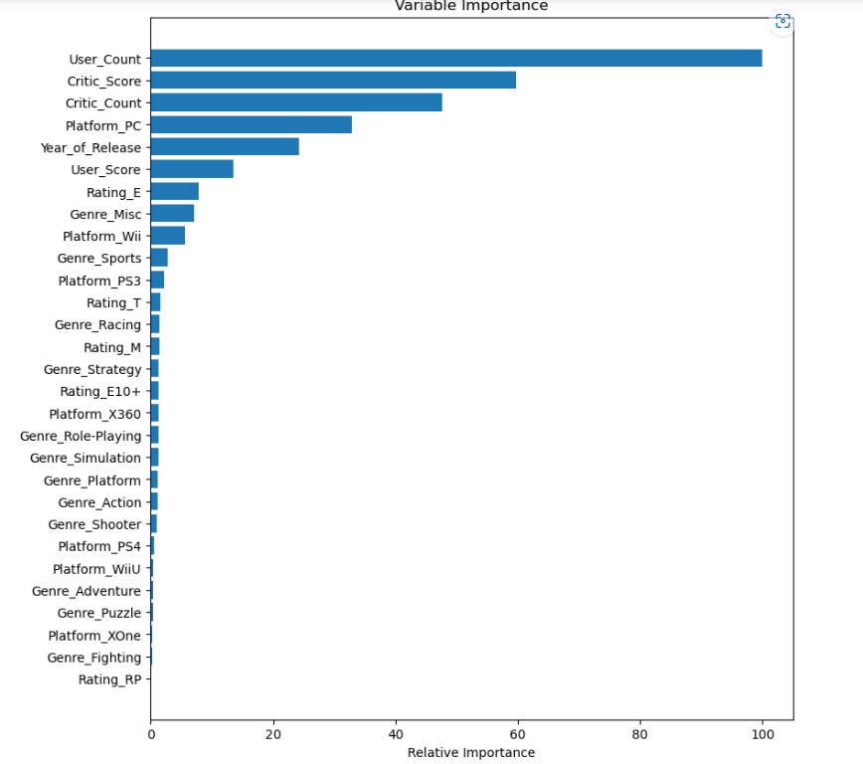
From the plot, User_Count is the most significant variable.

Slide 20

THANK YOU!

